Slide 1
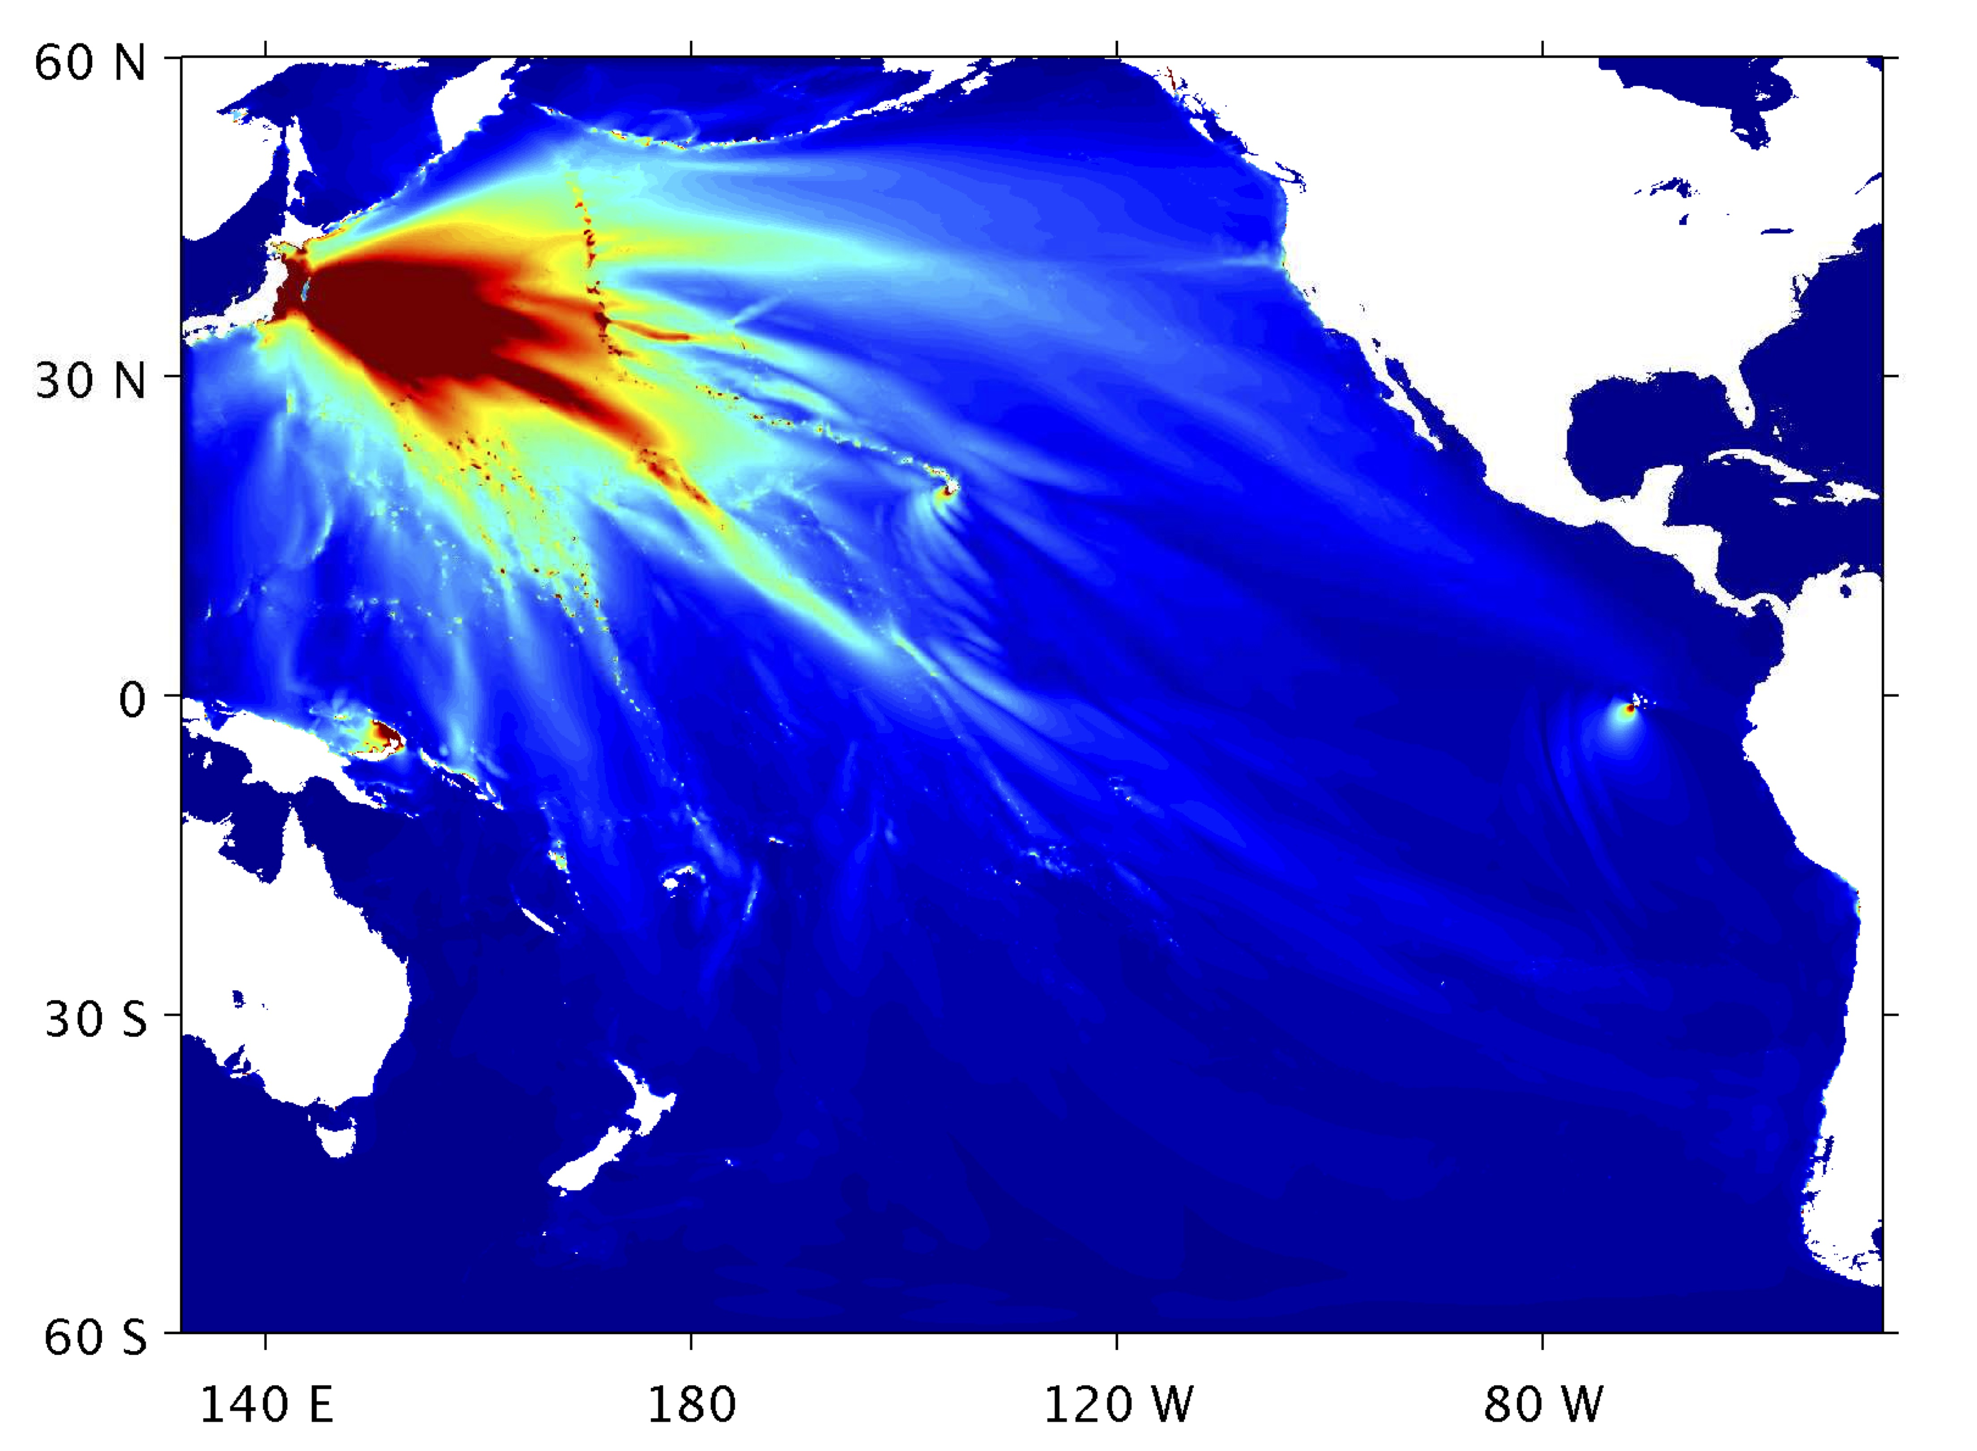
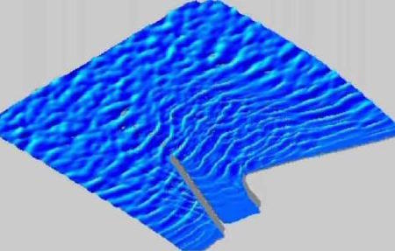

Slide 2
FUNWAVE-TVD: A Boussinesq model for simulating nearshore surface waves, currents and tsunamis from ocean-basin to nearshore scales.

